Slide 1
Wind Speed Prediction for Renewable Energy Planning
By Gopalakrishnan Kumar, MTech IIT-Bombay,
Freelance Data Science Consultant
LinkedIn: Profile Link : https://www.linkedin.com/in/gopalakrishnankumar-a73301110/
Github:https://www.github.com/Gopalakrishnan-Kumar/
Kaggle URL- https://www.kaggle.com/gopalkk2

Slide 2
Google Colab URL
https://colab.research.google.com/drive/1yDHBqsU_PxYDoqt6oGcXHNxYro6vjquf?usp=sharing

Slide 3
Introduction
The increasing reliance on renewable energy sources highlights the importance of wind energy as a sustainable alternative to fossil fuels. However, wind power generation depends heavily on fluctuating wind speeds. Reliable forecasting enables better grid integration, maintenance scheduling, and investment planning for wind farms. This project uses time series forecasting (ARIMA model) to predict wind speeds using historical patterns.

Slide 4
Objectives
The project aims to:
Forecast wind speeds based on historical data.
Provide insights into seasonal and long-term wind patterns.
Support renewable energy planning and optimization.

Slide 5
Dataset Description
The dataset used here is synthetic but realistic, simulating monthly wind speeds from 2010 to 2024.
Date: Monthly timestamps.
WindSpeed (km/h): Recorded wind speeds with seasonal and random variations.
This synthetic dataset reflects typical seasonal cycles (higher winds in monsoon/winter and lower in summer) along with random fluctuations.

Slide 6
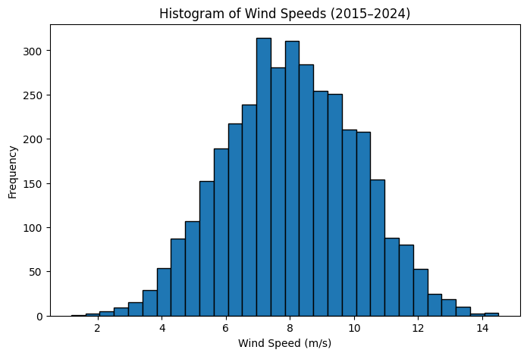
Data Visualization

Slide 7
Exploratory Data Analysis (EDA)
4.1 Histogram
Most wind speeds fall between 10–25 km/h.
A few higher values (~30–35 km/h) simulate stormy conditions.
The distribution is slightly right-skewed due to extreme weather events.

Slide 8
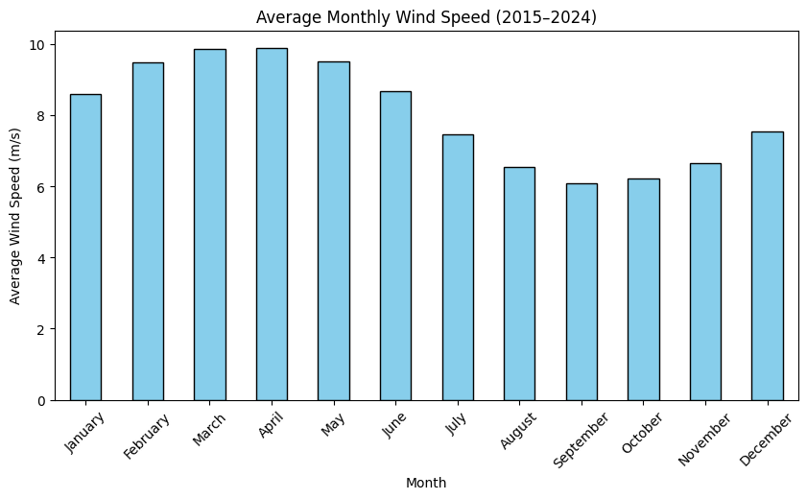
Data Visualization

Slide 9
Exploratory Data Analysis (EDA)
4.2 Bar Chart
Monthly averages reveal cyclical variations in wind speed.
Higher averages during monsoon and winter seasons.
Lower averages during summer months.

Slide 10
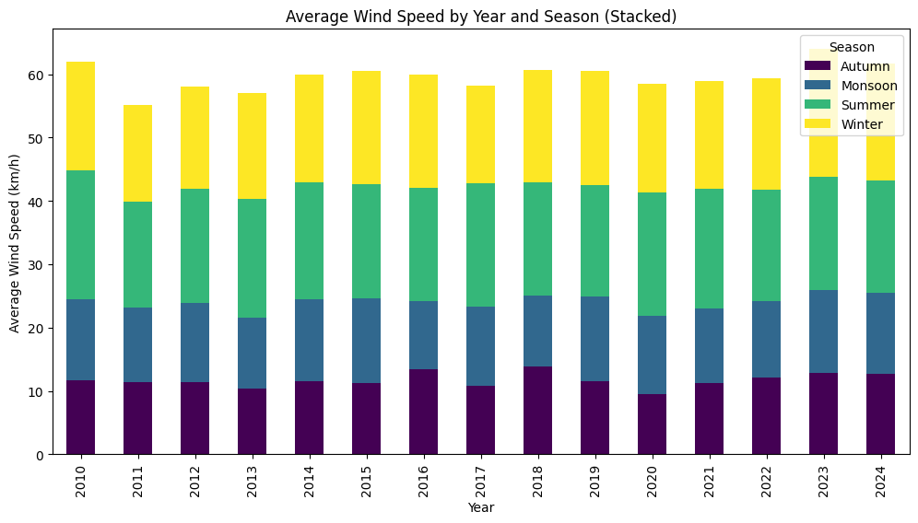
Data Visualization

Slide 11
Exploratory Data Analysis (EDA)
Stacked Bar Chart
Seasonal analysis shows monsoon contributes the highest wind speeds every year.
Winter is also significant, while summer remains consistently low.

Slide 12
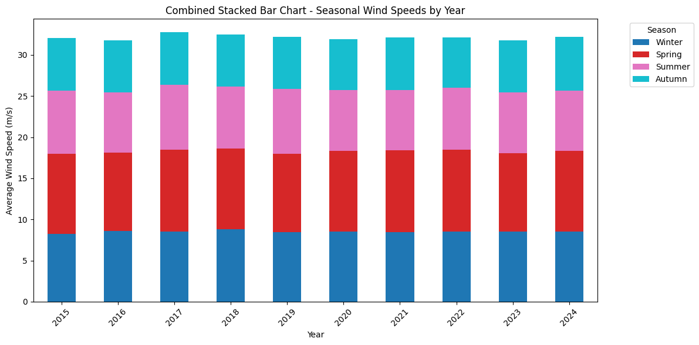
Data Visualization

Slide 13
Exploratory Data Analysis (EDA)
This visualization integrates seasonal contributions with the overall yearly average wind speed:
The stacked bars show how each season contributes to yearly averages.
The line plot overlay indicates the trend of total yearly average wind speed.
Insights:
Peaks in the line correspond to strong monsoon years.
Years with weaker monsoons show noticeable dips.
Long-term trend remains relatively stable with slight upward fluctuations.

Slide 14
Insights from EDA
Seasonality: Wind speed follows strong seasonal cycles, with Monsoon
being the most influential.
Yearly Variation: Some years show higher overall averages due to stronger
monsoon/winter winds.
Stability: Despite seasonal variation, the long-term yearly average is
relatively stable (~15–20 km/h).
Forecast Implication: Seasonal patterns must be considered for accurate
wind speed forecasting.

Slide 15
Conclusion
The EDA confirms that wind speed is seasonal and cyclical, with monsoon contributing most significantly. The combined stacked bar chart clearly highlights how seasonal effects aggregate into yearly averages, making it a valuable tool for renewable energy planners.

